Slide 1
DTI5125
Group Assignment 2: Clustering
Group: DSA_202101_13

Slide 2
Introduction
Generally, we used some machine learning algorithms like K-means, agglomerative clustering and Gaussian classifier. we find the best model is LDA with K-means and used some of vectorization methodologies such as BOW (Bag Of Words), BOW with less features, TF-IDF (term frequency-inverse document frequency) on words and bi-gram wise

Slide 3
Choosing the dataset
Gutenberg dataset
Preprocessing
Partitioning
Feature Engineering
BOW
Clustering Modelling
Applying LDA
Picking a champion model
K-means
Data cleaning
BOW with 2000 features
TF-IDF
TF-IDF with Bi-gram
Agglomerative Clustering
Gaussian Clustering
Sentiment analysis
Word frequency
K-means with LDA
Methodology

Slide 4
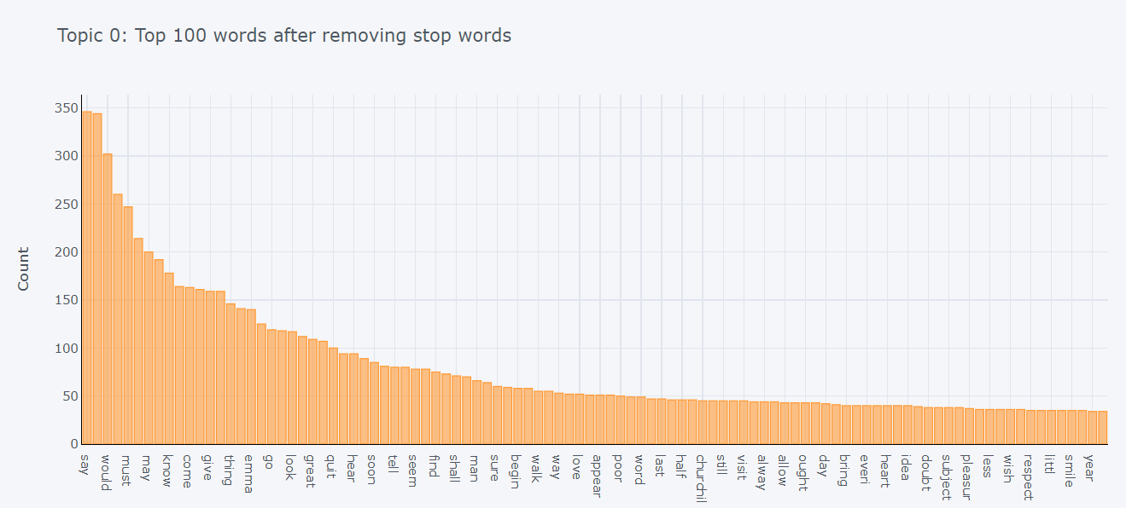
Most important 100 words

Slide 5
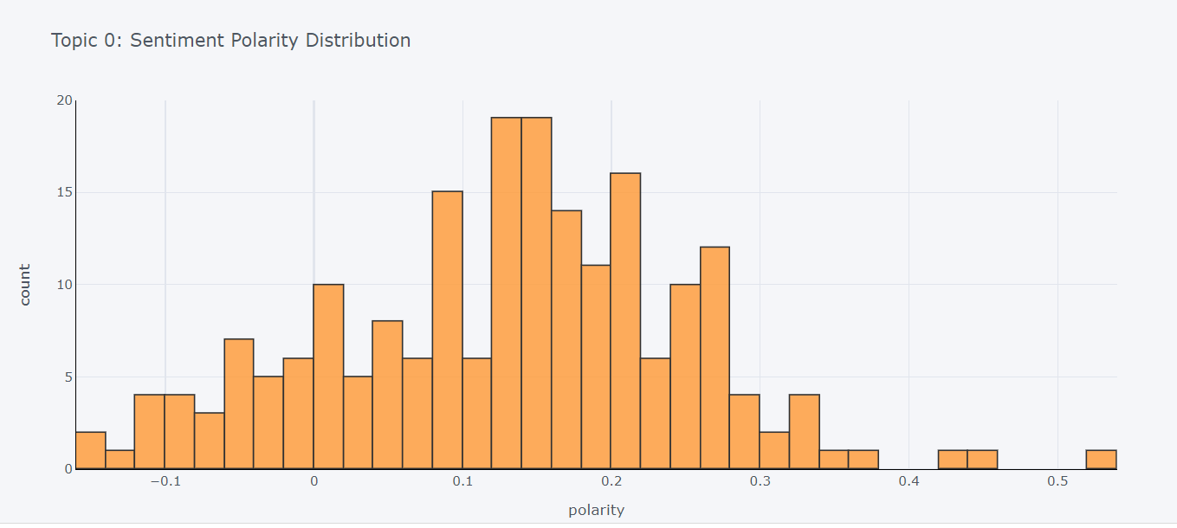
Polarity Distribution

Slide 6
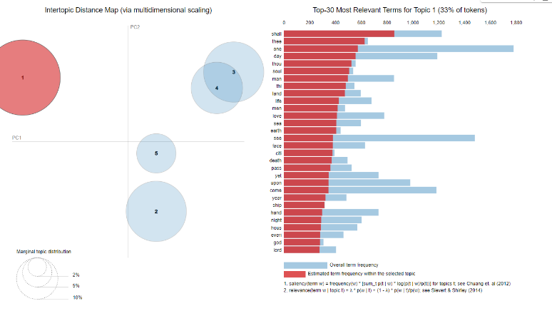
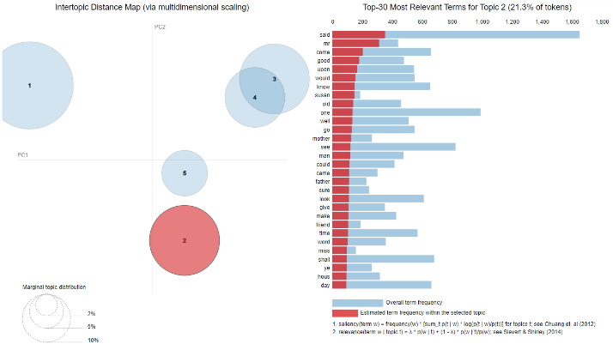
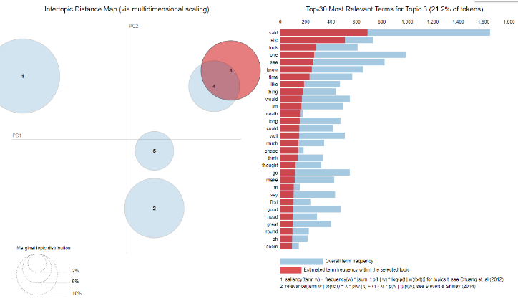
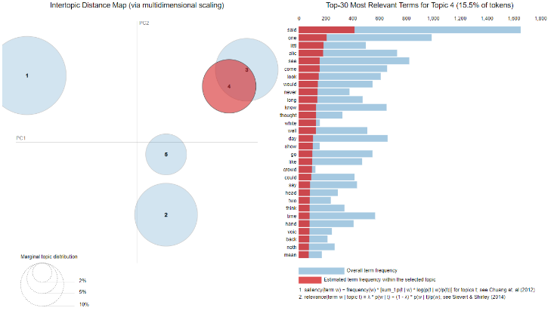
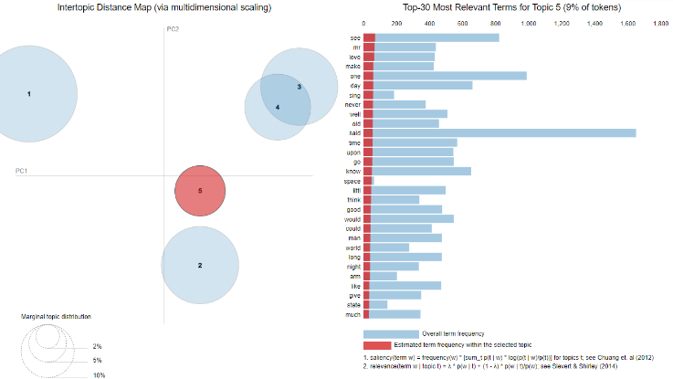
LDA analysis and topic analysis

Slide 7
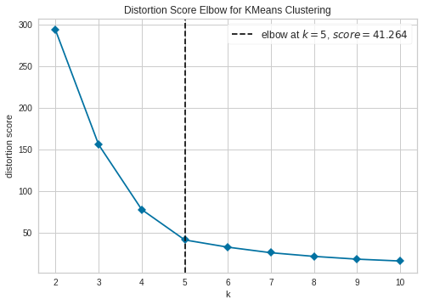
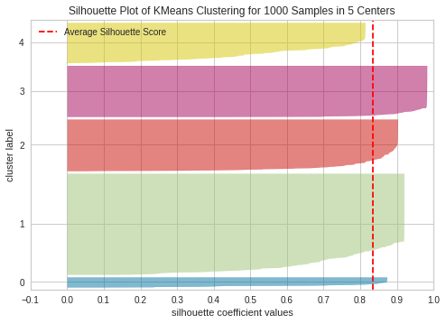
Model Evaluation

Slide 8
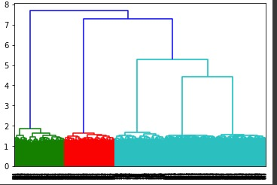
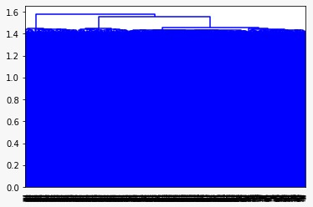
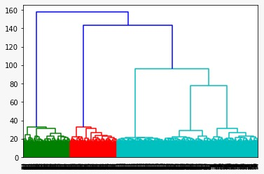
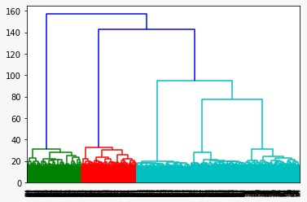
Dendrogram Visualization
Agglomerative TF-IDF
Agglomerative TF-IDF / Bi-gram
Agglomerative
BOW
Agglomerative
BOW with 2000 feature

Slide 9
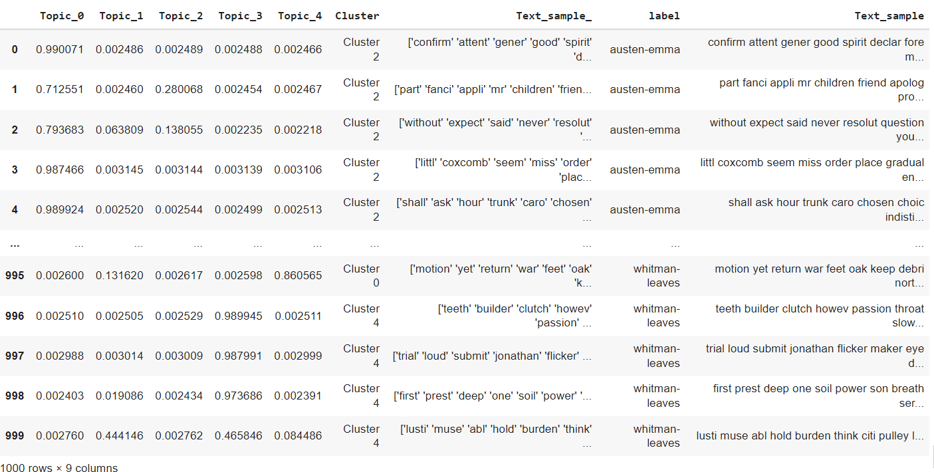
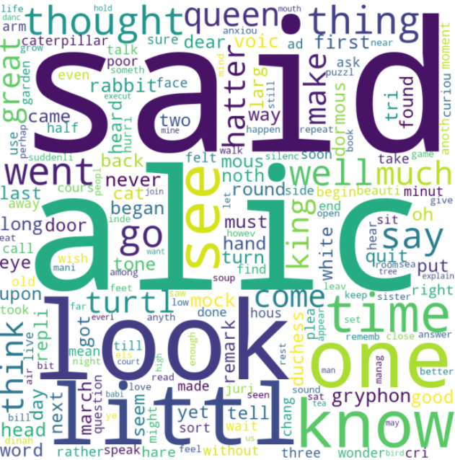
Champion Model: K-means with LDA

Slide 10
Overall Results
 | K-means BOW | Agg. BOW | Gaussian BOW | K-means BOW 2000 | Agg. BOW 2000 | Gaussian BOW 2000 | K-means TF-IDF | Agg. TF-IDF | Gaussian TF-IDF/ PCA | K-means TF-IDF / Bi-gram | Agg. TF-IDF / Bi-gram | Gaussian TF-IDF / Bi-gram/ PCA
Kappa score | 1 | 0.25000 | 1 | 1 | 0.99625 | 1 | 1 | 1 | 0.25000 | 0.25000 | 0.25000 | 1
Silhouette score | 0.62691 | 0.062411 | 0.062691 | 0.063068 | 0.062696 | 0.063068 | 0.044823 | 0.044823 | 0.044823 | 0.04558 | 0.04541 | 0.8345
Coherence | 0.620658 | 0.620658 | 0.620658 | 0.620658 | 0.620658 | 0.620658 | 0.620658 | 0.620658 | 0.620658 | 0.620658 | 0.620658 | 0.620658

